Slide 1

The Collaborative Approach – Pilot Considerations and Pilot Solutions
Captain Adrian Abraham
22nd May 2012
Notes:
Good morning everybody, What a pleasure it is for me to be here in beautiful Bali and to have the honor to speak to all of you.

Slide 2
Pilot Considerations
Threat Managers at the Sharp End.
Airport Threats:
  Construction.
  Communication.
  Markings and Signs.
  Birds / Wildlife.
  Weather.
Notes:
So Pilots, what is up with those guys?
Always so grumpy – filing hazard reports.
Traditionally viewed as “Last Line of Defense” The Savior of everyone one board the dangerous airplane, The Hero of the Day.
What a load of rubbish.
The truth is everyone that commits themselves to safety is a Hero and that means each and everyone of us here today.
We are all links in a chain that will save lives, in light of the loss of the 45 so recently, this is a fitting call to action – on all matters of flight safety.
Pilots are at the Sharp End of the stick, they are the ones face the threats, they are the ones that must manage these threats.
What are these Threats
Anytime there is a NOTAM on construction at an airport, this tells a pilot, everything his charts are telling him about the airport may not be right.
Runway lengths may be different, which means he may not be able to carry his usual payloads into that airport. This is somethine he will need to deal with before leaving his point of departure.
Taxiways may be closed, which means the way he taxied to the terminal the last time he was at this airport will not be the same this time. This, as is any runway shortening will be Notamed.
They may be stray equipment or foreign objects on the runway and taxiways.
Pilots may be come across many different accents during of the course of a flight, more accurately though they will come across many different applications

Slide 3
Pilot Solutions
Runway Safety Teams
Emphasis on R.T. Phraseology
Runway Audits – Markings and Signs.
Technology
Risk Register
The Power of the Internet

Slide 4
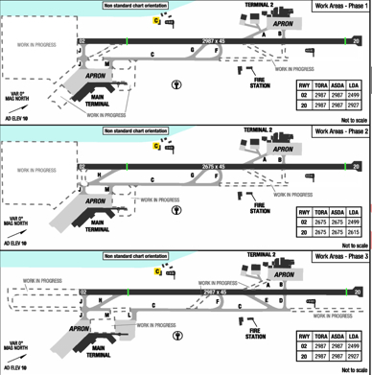
Outdated Information on Taxiway charts and Notams during construction.

Slide 5
Outdated Information on Taxiway charts and Notams during construction.

Slide 6
Outdated Information on Taxiway charts and Notams during construction.

Slide 7
Outdated Information on Taxiway charts and Notams during construction.

Slide 8
Outdated Information on Taxiway charts and Notams during construction.

Slide 9
THANK YOU

